Slide 1
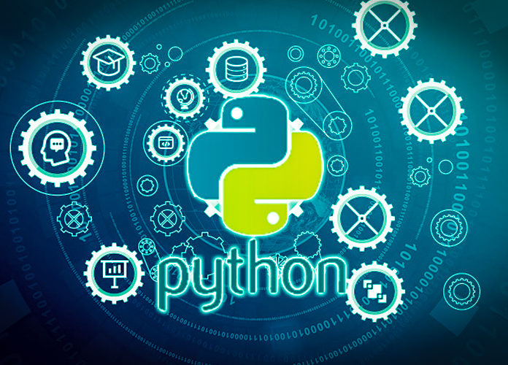
Data Programming in Python _________________ Machine Learning

Slide 2

Machine Learning Objective
Computers make decisions or learn based on data
Supervised: Use features (X) to predict target (y)
Unsupervised: Finding hidden patterns, groups in unlabeled data

Slide 3

Before Machine Learning
No missing values
Data in numeric format
Stored in pandas df or np array
Create dummy variables
Feature transformation

Slide 4
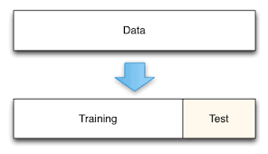
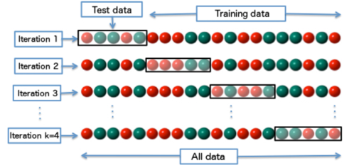
Training and Testing Data
Split data so some is used to fit (train) the model and the other is used to test
Could be 80/20, 70/30, 90/10 split
Can also use cross-validation

Slide 5
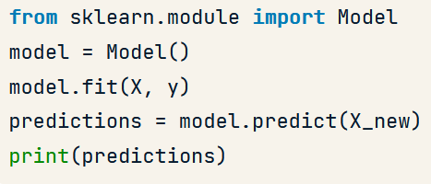
General format
Import sklearn module and model
Create a model object
Fit your data to that model
Make predictions or test accuracy

Slide 6
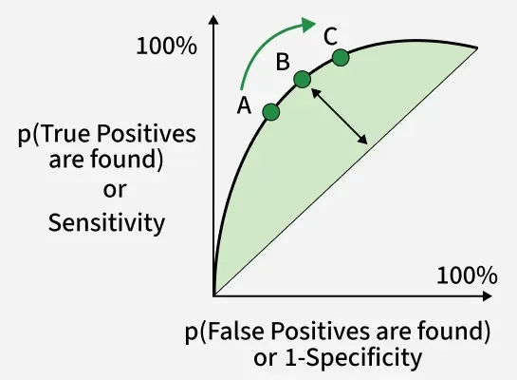
Scoring Measures
Accuracy or R^2 (Regression)
F1 Score
Area under ROC Curve

Slide 7
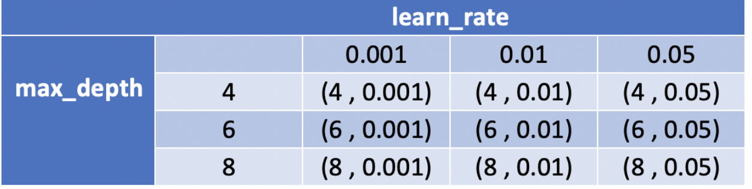
Model Selection
Best scoring performance
Change hyperparameters
Options for each model
Systematically done with GridSearch

